Slide 1
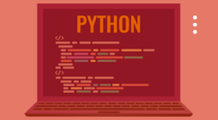

CWCT 140
Professor David Lieberman
dlieberman@ivytech.edu

Slide 2

Introduction
Visiting Professor for 14 years
Software developer by trade
Small business owner since 1986
Employer of software interns from local Bay Area technical colleges (DeVry Technical Institute, Delta College)
www.computer-methods.com

Slide 3
Ivy Learn
IvyLearn Point of Contact for Announcements
Lecture slides will be published to the “Lecture” folder in the Files area
Content Presented on Cisco's Networking Academy
You should have received an invitation

Slide 4
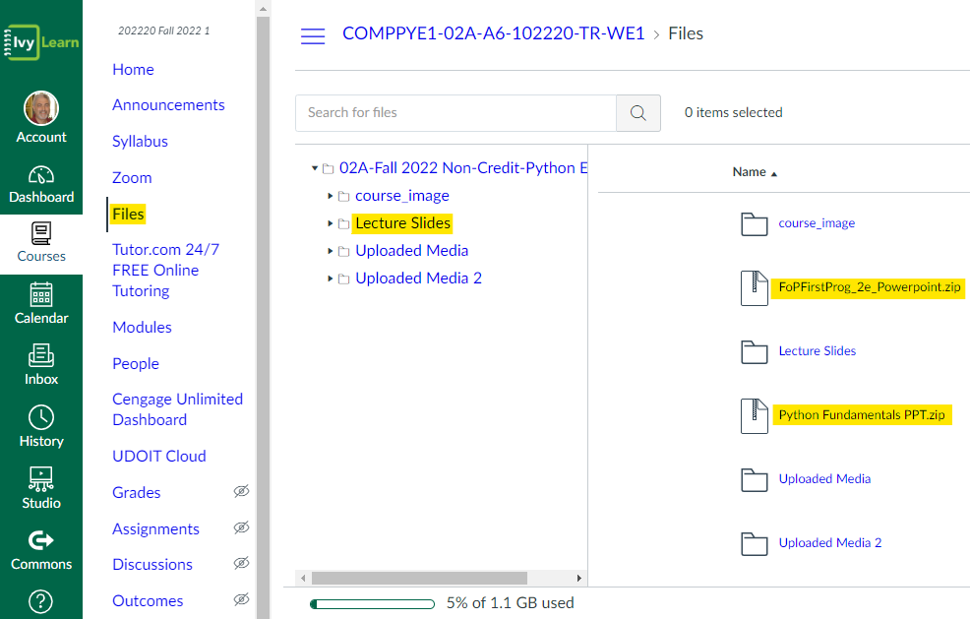
Ivy Learn

Slide 5
Agenda
Languages
Compiler vs Interpreters
IDE (Integrated Development Environment)
Python Language
Using the Sandbox
How to screw up and fix it

Slide 6
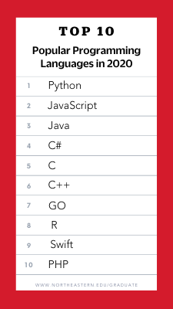
Languages
https://www.northeastern.edu/graduate/blog/most-popular-programming-languages/

Slide 7
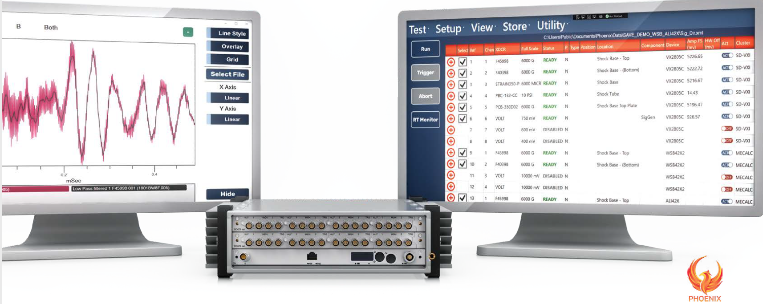
Why Python? A Case Study
My client (MeCalc) manufactures data systems for analog to digital conversion
https://www.mecalc.com/

Slide 8
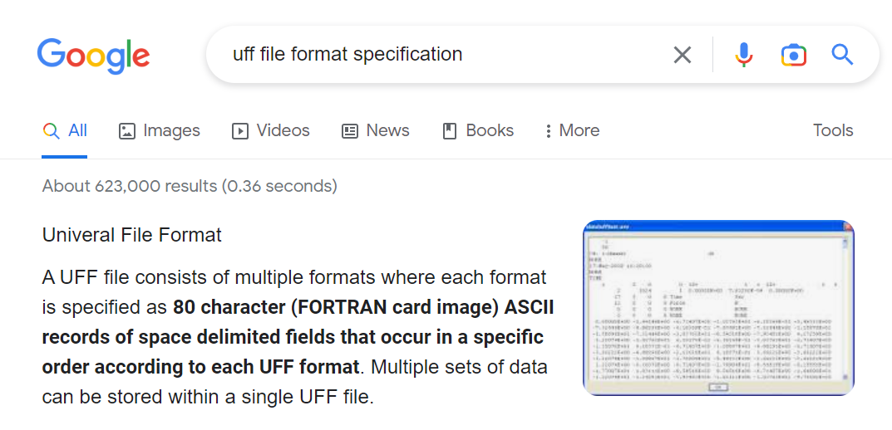
Why Python? A Case Study
Client requested that data be exported in “UFF-58” format
https://www.ceas3.uc.edu/sdrluff/view.php

Slide 9
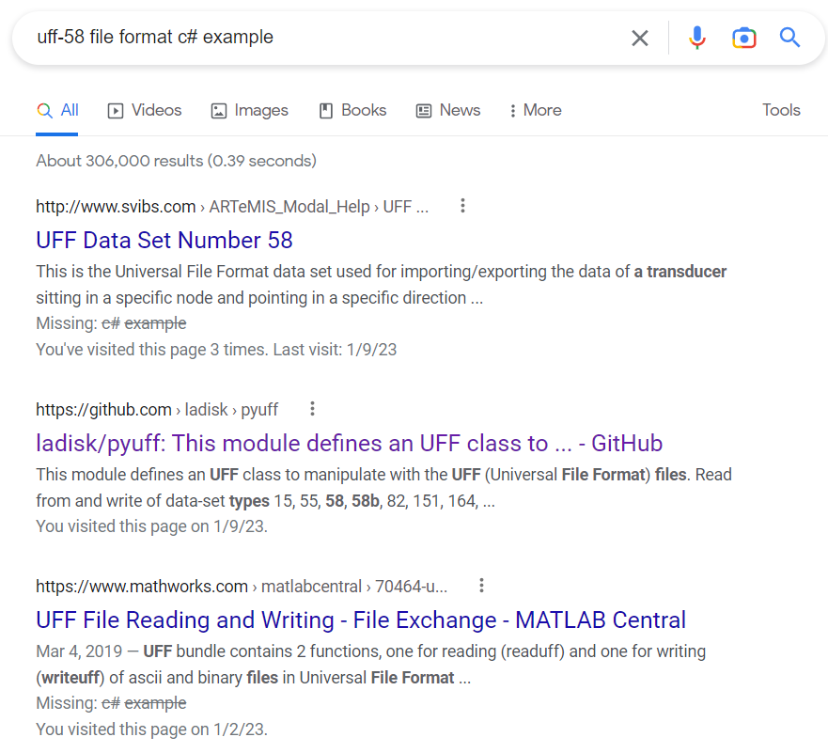
Why Python? A Case Study

Slide 10
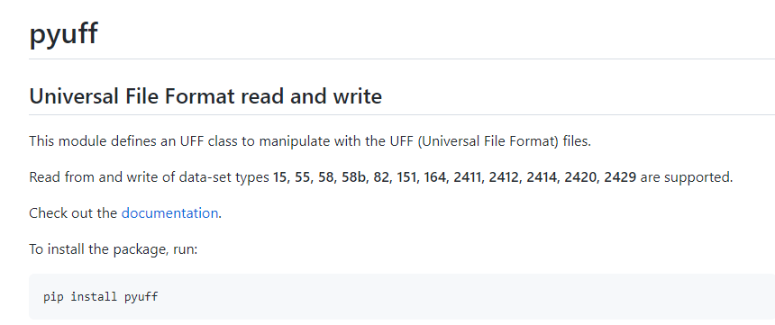
Why Python? A Case Study

Slide 11
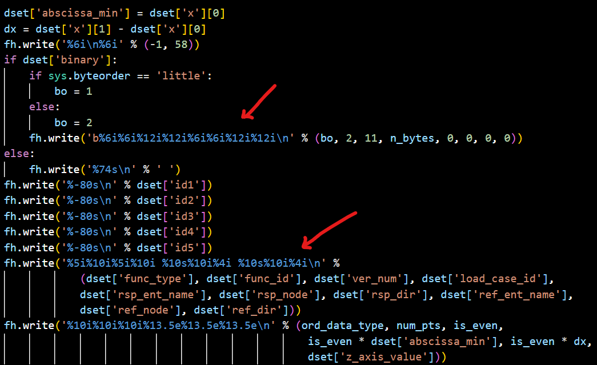
Why Python? A Case Study

Slide 12
Compiler vs Interpreter
An interpreter produces a result directly from a human-readable program
A compiler generates assembly language code that operates in binary at the machine level

Slide 13
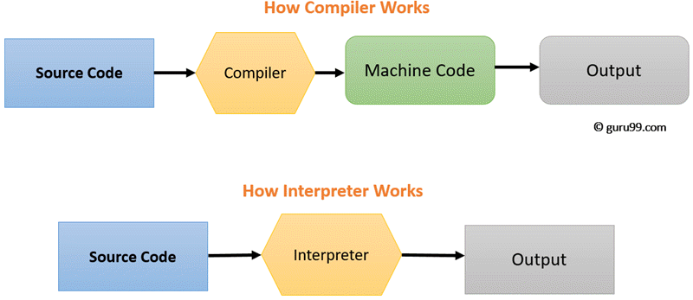
Compiler vs Interpreter

Slide 14
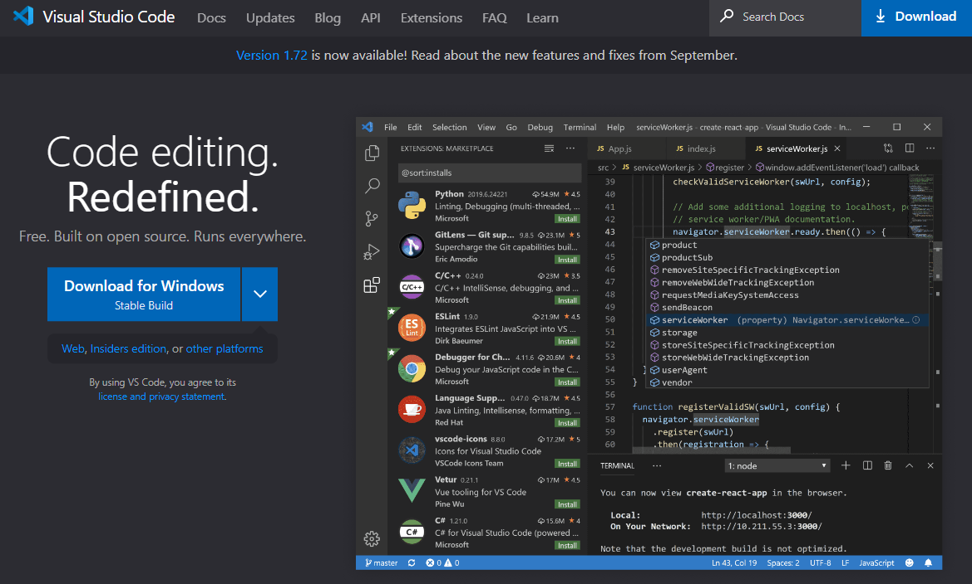
IDE
https://code.visualstudio.com

Slide 15
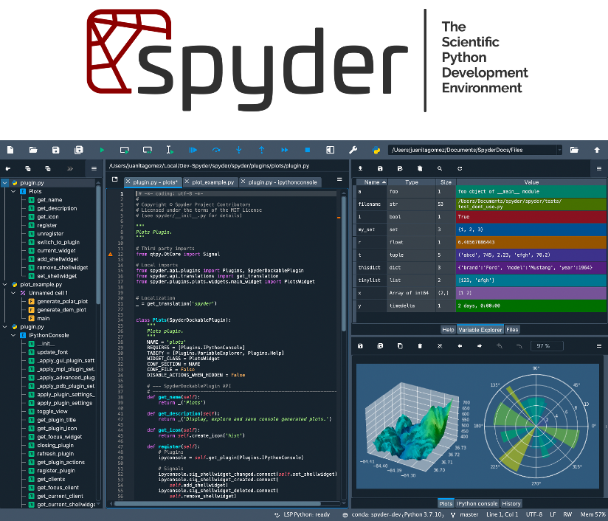
IDE
https://www.spyder-ide.org

Slide 16
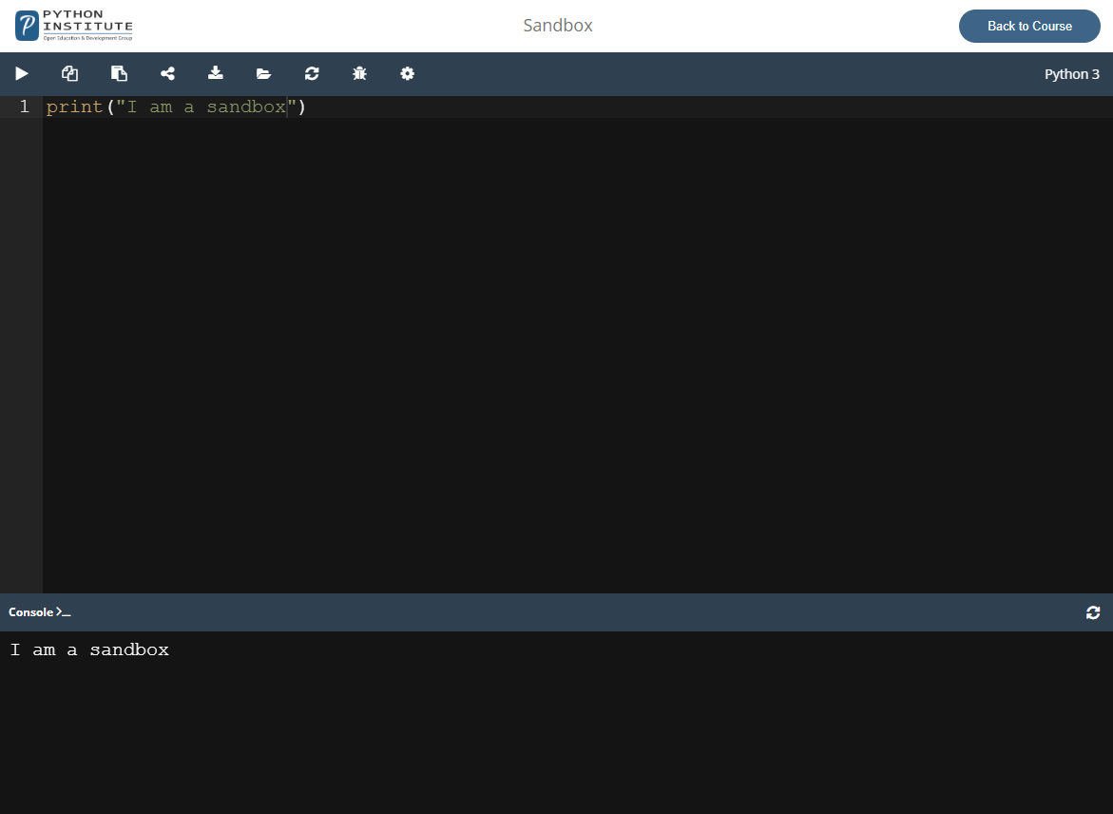
IDE
Netacad Sandbox

Slide 17
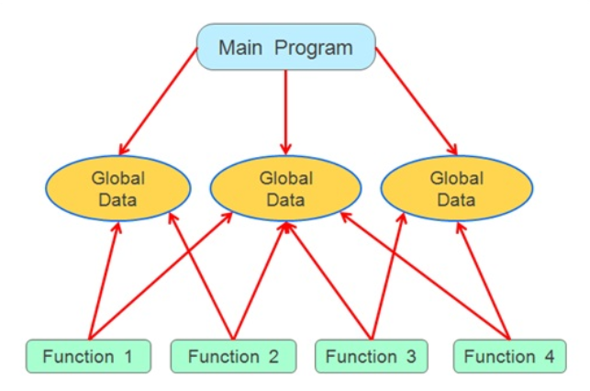
Procedural Programming

Slide 18
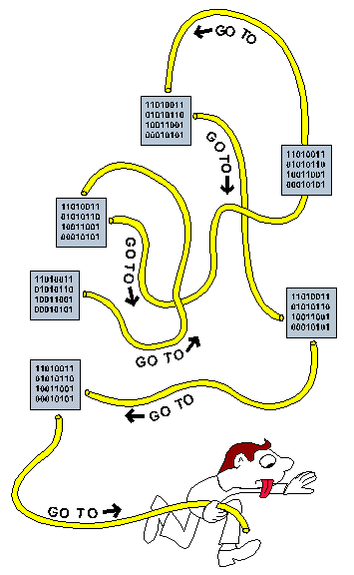
Procedural Programming
“Spaghetti” Code

Slide 19
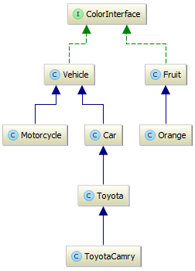
Object-Oriented Programming
Modular Code

Slide 20
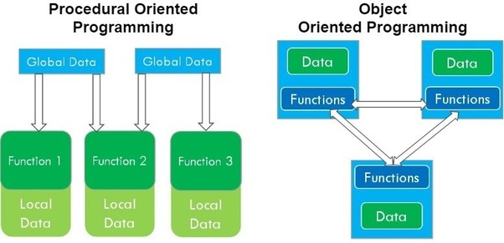
Procedural Vs Object-Oriented
In OOP, each “object” is self-contained

Slide 21
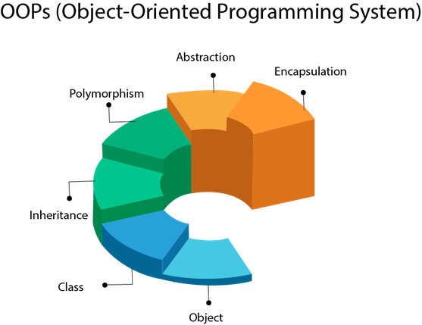
Features are predominant in OOP languages:

Slide 22
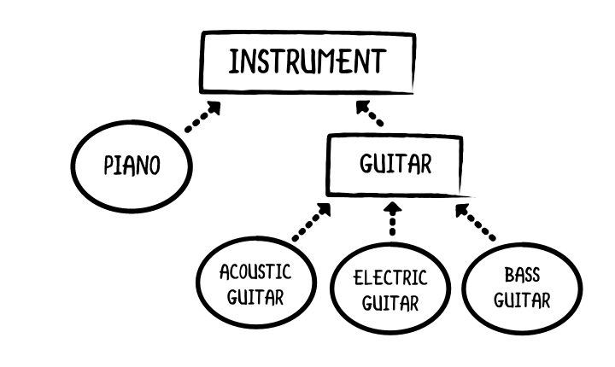
Classes and Objects
Classes
Objects

Slide 23
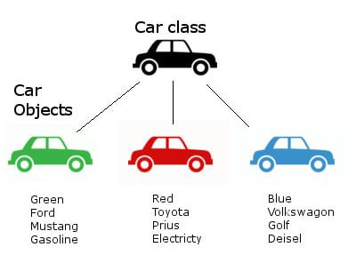
Classes and Objects

Slide 24
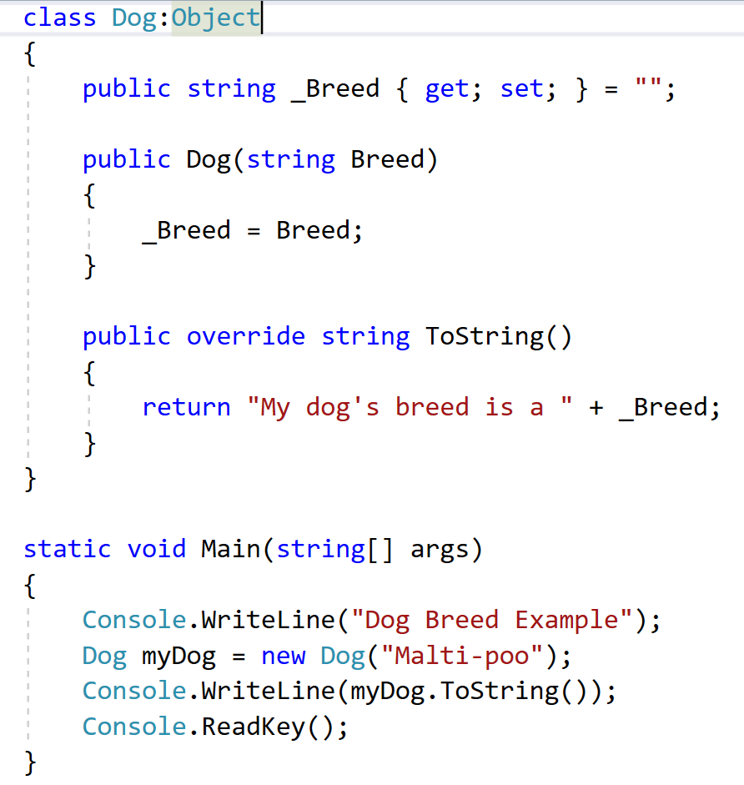
C# Example
Inheritance
Accessor
Overloaded Constructor
Abstract Method Overridden
Instantiation

Slide 25
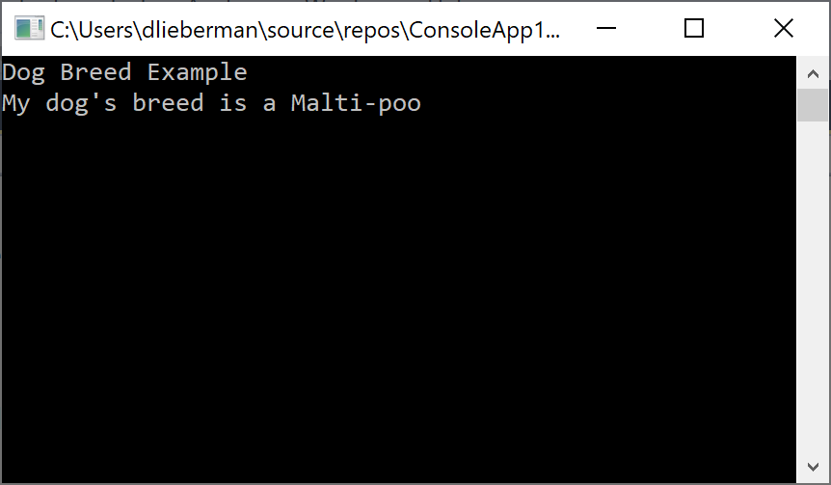
C# Example

Slide 26
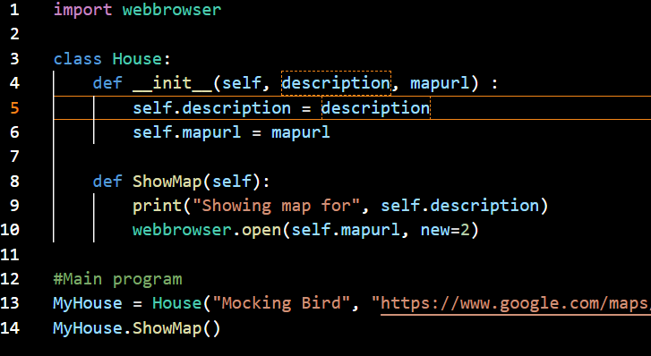
Python OOP Example

Slide 27
Python Language
Syntax
Print
If Then Else
While Loops
Lists
For Loops
Exceptions
Input

Slide 28
Python Syntax
Indentation refers to the spaces at the beginning of a code line.
Python uses indentation to indicate a block of code
if 5 > 2: print("Five is greater than two!")
print(“Hello”)
Correct
if 5 > 2: print("Five is greater than two!")
Incorrect

Slide 29
Python Print
Print a single line
print("Hello World")
Print variables
print("The answer is = ", total)

Slide 30
Python If Statement
a = 200 b = 33 if b > a: print("b is greater than a") elif a == b: print("a and b are equal") else: print("a is greater than b")

Slide 31
Python If Statement
Equals: a == b
Not Equals: a != b
Less than: a < b
Less than or equal to: a <= b
Greater than: a > b
Greater than or equal to: a >= b

Slide 32
Python While Loop
i = 1 while i < 6: print(i) i = i + 1
i = 1 while i < 6: print(i) if i == 3: break i += 1
#...

Slide 33
Python Lists
thislist = [1, 5, 7, 9, 3]
print(thislist)
thislist = ["apple", "banana", "cherry"] print(thislist)

Slide 34
Python For Loop
for x in range(6): print(x)
Note that range(6) is not the values of 0 to 6, but the values 0 to 5.
for i in range(6): print(i) if i == 3: break #...

Slide 35
Python For Loop
for x in range(0, 6, 2): print(x)
Spans the range of 0 to 5 with an increment of 2.

Slide 36
Python For Loop
fruits = ["apple", "banana", "cherry"] for x in fruits: print(x)
fruits = ["apple", "banana", "cherry"] for x in fruits: print(x) if x == "banana": break

Slide 37
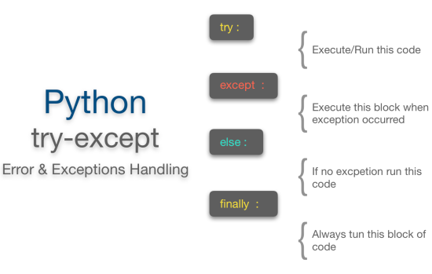
Exceptions – Try / Except

Slide 38
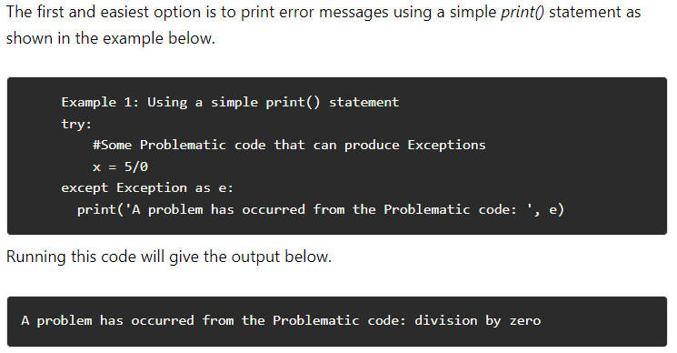
Exceptions – Show the Error

Slide 39
Exceptions – Example
# Exception Handling
a = 10
b = 0
try:
print(a / b)
except:
print("Got an error!")
PS C:\Users\dlieberman\Documents\CEIS150> & C:/Users/dlieberman/AppData/Local/Microsoft/WindowsApps/python3.9.exe c:/Users/dlieberman/Documents/CEIS150/test2.py
Got an error!
PS C:\Users\dlieberman\Documents\CEIS150>

Slide 40
Exceptions – Example
# Exception Handling
a = 10
b = 0
try:
print(a / b)
except Exception as e:
print("Got an error!")
print(str(e))
PS C:\Users\dlieberman\Documents\CEIS150> & C:/Users/dlieberman/AppData/Local/Microsoft/WindowsApps/python3.9.exe c:/Users/dlieberman/Documents/CEIS150/test2.py
Got an error!
division by zero
PS C:\Users\dlieberman\Documents\CEIS150>

Slide 41
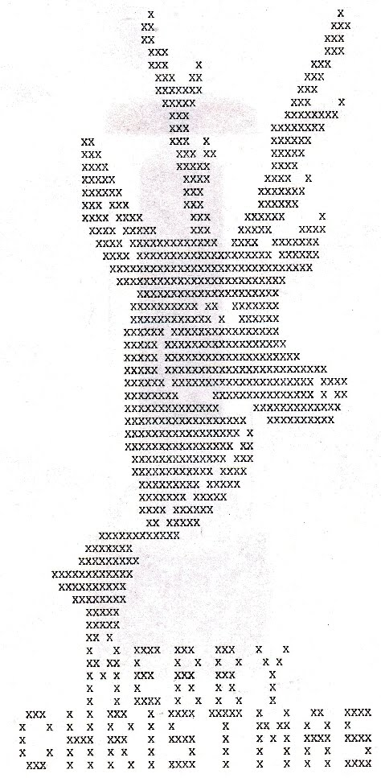
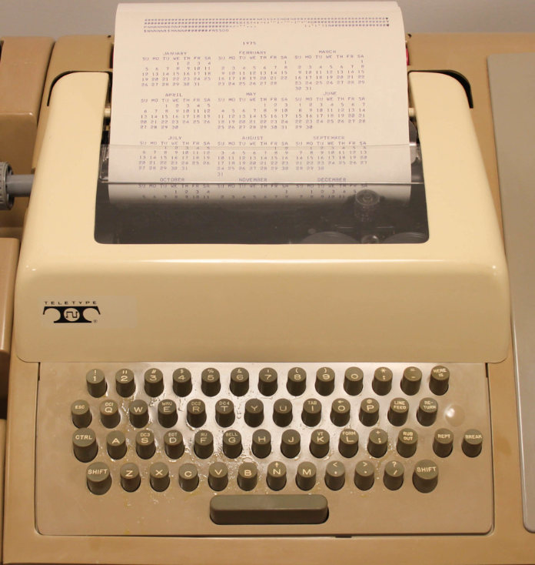
ASCII Art

Slide 42
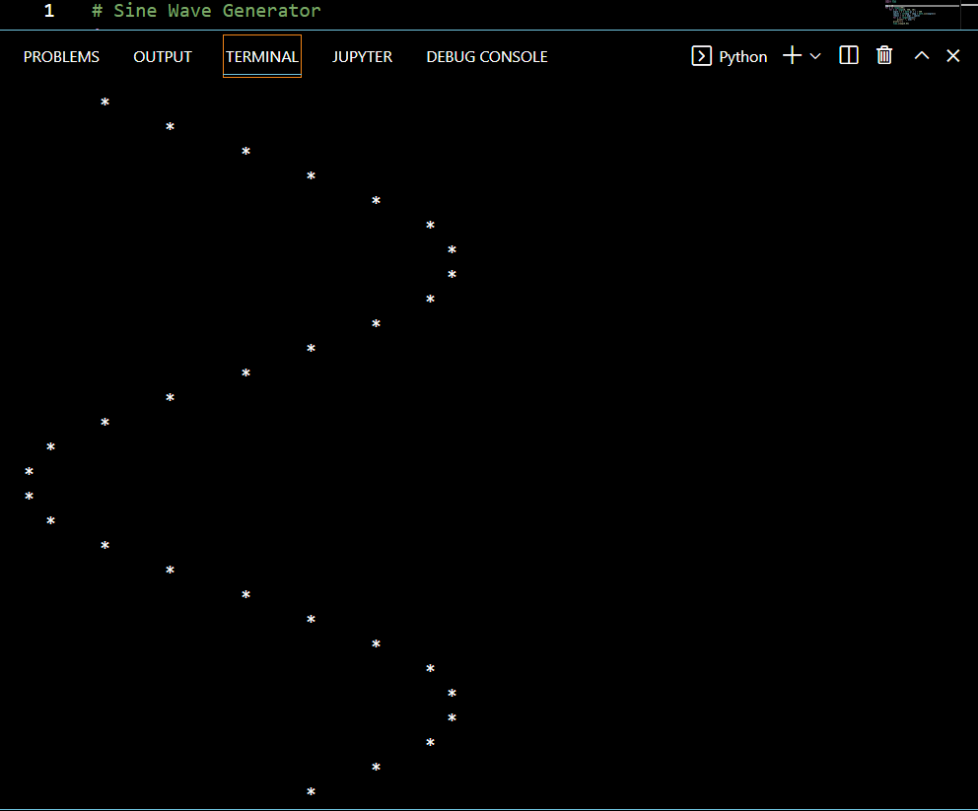
Python Sine Wave Generator

Slide 43
Pseudo-Code
Initialize global variables
Outer loop to repeat wave cycles
Inner loop to calculate sine wave angle
Calculate number of spaces to skip
Print spaces without return
Print a plotting symbol with return
Next angle
Play it again Sam…

